Slide 1

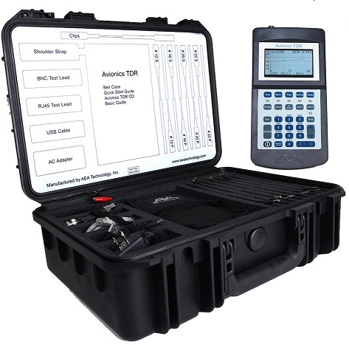
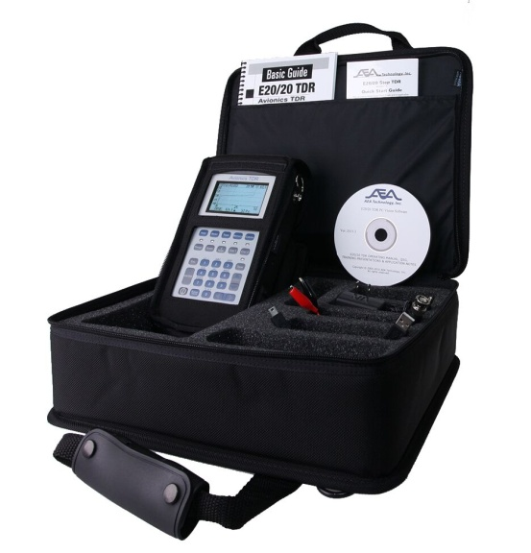
Avionics TDR
Operator Training
January 24, 2012
Revised 6/14/2016

Slide 2

Table of Contents
Subject Slides
Avionics TDR Kit and Avionics TDR Plus Accessories 3-8
About the Avionics TDR models 9-11
Battery installation, primary and alternatives 12
How TDR’s work and Cable Construction 13-19
Measurement Screen & Example Traces 20-25
Power On, Resets, Keypad and Menu Keys 26-35
Function Keys 36-40
Advanced Features 41-47
ETDR PC Vision 48-55
Cleaning Avionics TDR 56
Warranty, Maintenance & Contact Into 57
Questions & Acknowledgements 58
Use arrow keys on the right to jump directly to desired slides
2

Slide 3
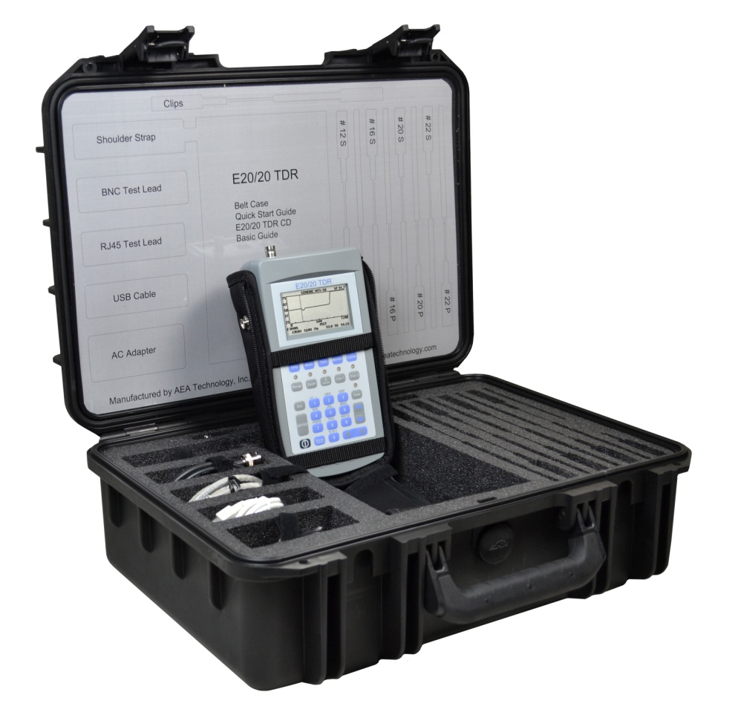
Avionics Kit Carrying Case
Customized Carrying Case
Anti-FOD design
1. Retention for all components
2. Lid label for contents ID
ATA 300 Category 1 rating
MIL-STD 810F Impact Damage,
UV, Solvents, and Anti-fungus
MIL-STD C4150J Waterproof and
Dust Tightness
MIL-STC 648C Ambient
Pressure Equalization
3

Slide 4
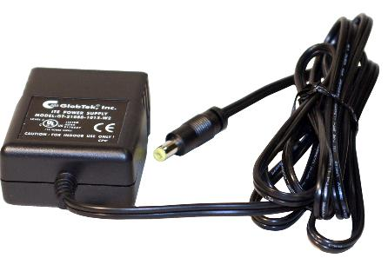
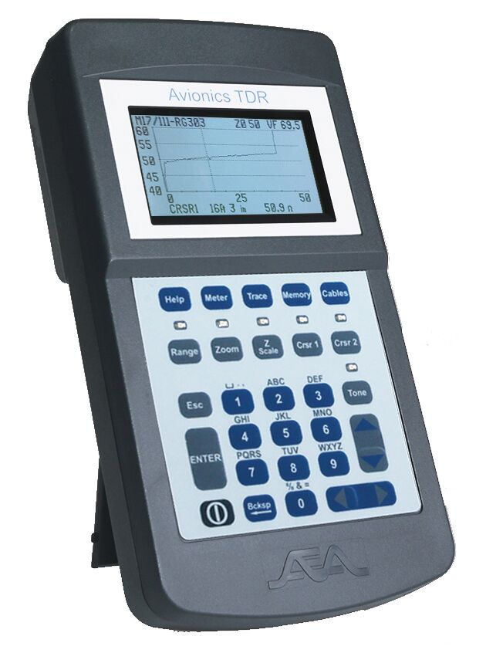
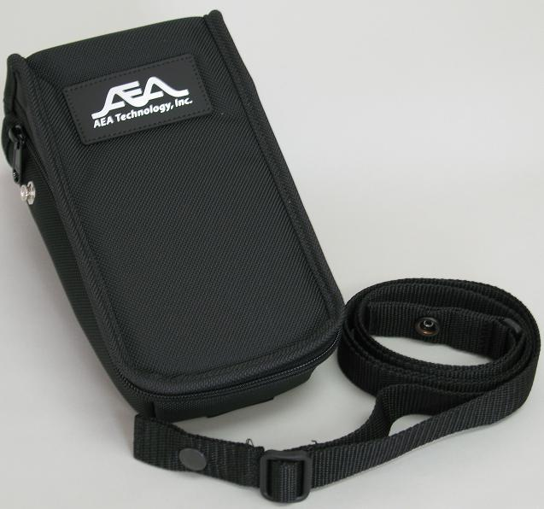
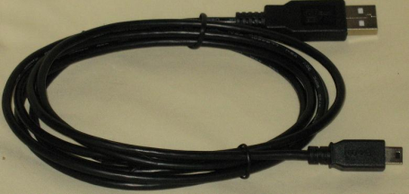
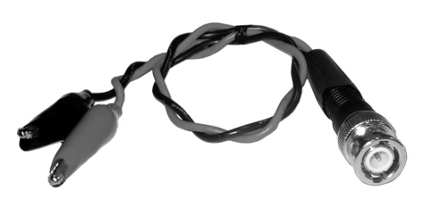
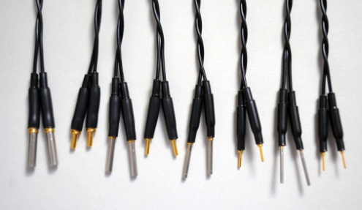
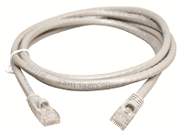
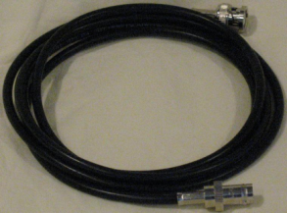
Avionics TDR Kit Included Accessories
AC Power Adapter
USB Cable
A-to-Mini B
Belt Case
Avionics TDR
RJ-45 Test Lead
6 ft (2m)
BNC Coax Lead
6 ft (2m)
BNC-to-Alligator Leads
BNC- to- #12, 16, 20, & 22
Pins & Socket Test Leads
4

Slide 5
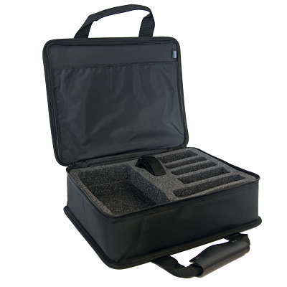
Avionics TDR & Included Accessories
AC Power Adapter
Belt Case
Avionics TDR
BNC-to-Alligator Leads
USB Cable
A-to-Mini B
Soft Carrying Case
5

Slide 6
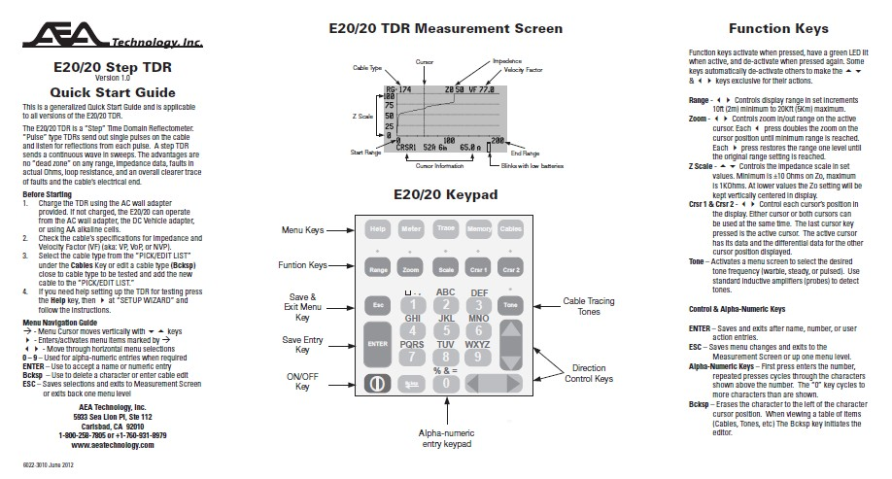
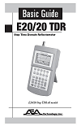
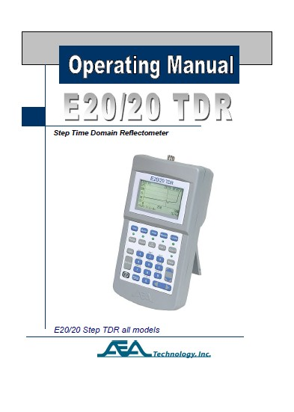

Avionics TDR Kit and Avionics TDR Included Literature
Quick Start Guide
Basic Guide
(Printed Copy)
Operator Manual
(Electronic Copy)
Calibration Certificate
6

Slide 7
CD-ROM
CD Folders
ETDR PC VisionTM Software - MS Windows 7®, Win 8.0 & 8.1®
and Win 10®
FTDI Driver (required to communicate with the TDR)
TDR Application Notes - - - - - 20+ Detailed Notes on TDR uses
Operation Manual - - - - - - - - - Electronic Copy Only
Basic Guide - - - - - - - - - - - - - Backup to Printed Copy
Quick Start Guide - - - - - - - - - Backup to Printed Copy
Training PPTs - - - - - - - - - - - - Avionics Technician
Also available at: www.aeatechnology.com
7

Slide 8

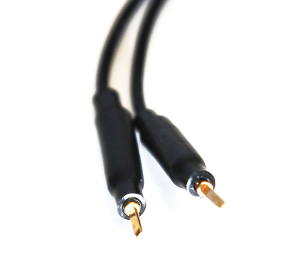
Optional Accessories
Tyco-Raychem Test Leads
Close-up view of pins
8

Slide 9
Avionics TDR Layout
BNC & RJ-45 Test Ports
Quarter VGA backlit display
High tactile feel & weather resistant
keypad with Function Key LEDs
Rugged ABS plastic case with
prop stand on the back
Meets:
MilStd 810G Transient Drop &
Explosion Proof
MilStd 461F EMI Susceptibility &
Emissions
MilPRF 28800 Environmental
9

Slide 10
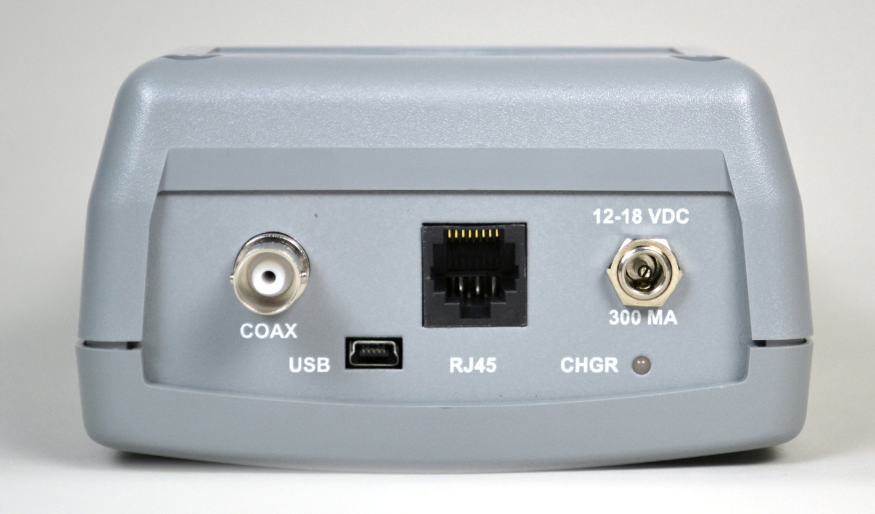
Avionics TDR Top End
BNC Connector
DC Input
power jack
USB-2 Mini Port
Charging
Indicator LED
RJ-45 Port
10

Slide 11
TDR is RF Shielded & Explosion Proof
Exceeds MilStd 461F for both EMI
emissions and susceptibility
Meets MisStd 810G, Method 511.5,
Procedure 1 for explosion proof
Precautions:
Do NOT recharge, operate on A/C
adapter or change batteries in an
explosive atmosphere
2. The TDR can NOT generate a spark, but
cables under test can from either live
voltages or static build-up. Ensure these
conditions to NOT exist as connection to
the TDR could cause a spark.
11

Slide 12
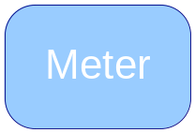
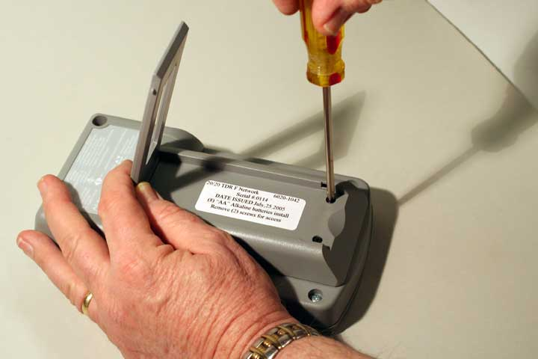
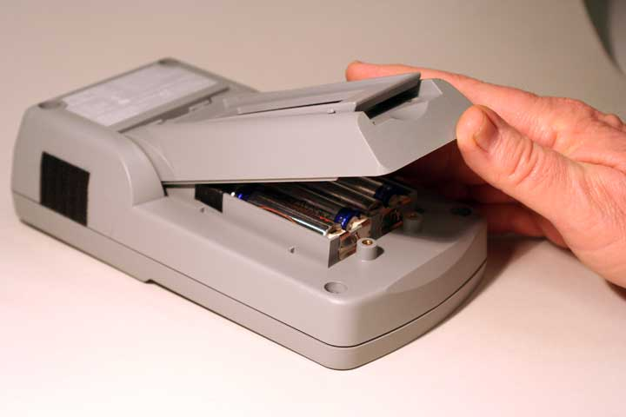
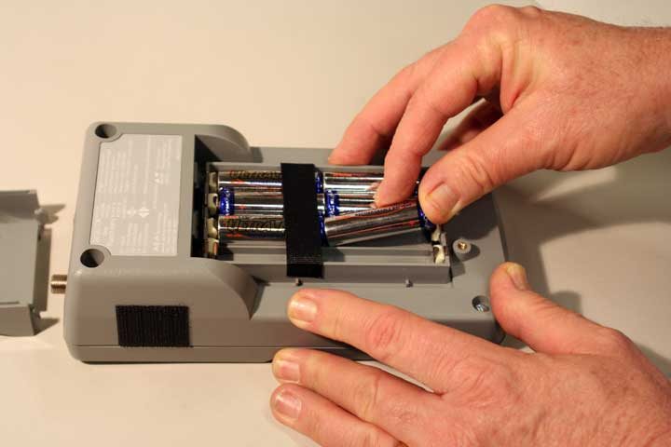
Battery Installation
BATTERY MENU
Select Alkaline or
NiMH/NiCd and
enter rated mAhrs
CAUTION
NO mixing cells
Same Type & mAhr
Lion
Skip Theory and Example Traces

Slide 13

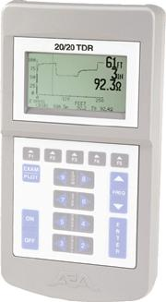
How Does a TDR Work?
The same as RADAR
Time
13

Slide 14
Cable Velocity and Distance
Velocity is designed in a cable at the time of its manufacture
Velocity is expressed as a fraction of the speed of light
Examples: .66c or 66.7c
Time
2
X Velocity = Distance
20 n Sec
2
X .66c (648,172,800ft/sec) = 6.48 feet
VF
or
VP
VoP
or
NVP
Beware of VF Uncertainty
14

Slide 15
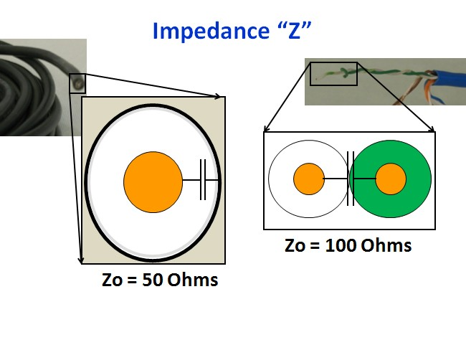
Term “Zo” refers to the manufacturer’s
impedance being used for testing
15

Slide 16
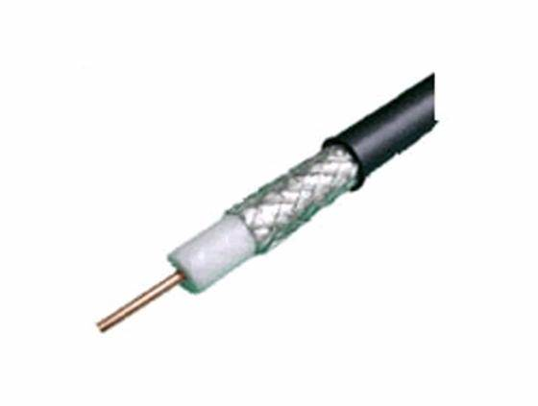
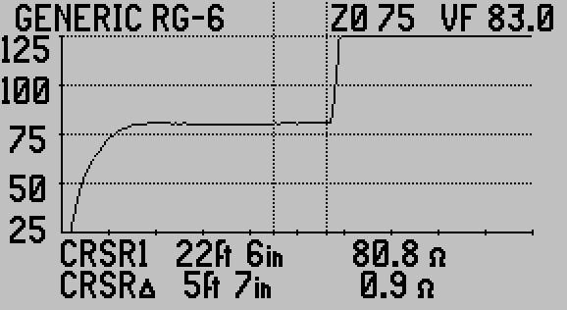
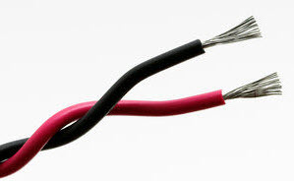
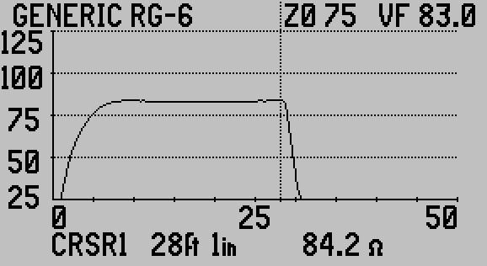


Cable Impedance (Z) and Reflections
Impedance is a factor of both the conductor and the dielectric of
the insulation between the conductor & shield or twisted pairs
Any deviation from the manufactured Z will cause reflections
Z = ∞Ω
Open
Zo=50Ω or 100Ω
Touching
Zo=50Ω or 100Ω
Short
Z = 0Ω
16

Slide 17
Pulse TDR
Pulse TDR
Longer and Longer Dead Zones
No impedance readings
Fault sizes are relative to distance, pulse width, and gain setting
No loop resistance
Some faults can not be detected
17

Slide 18
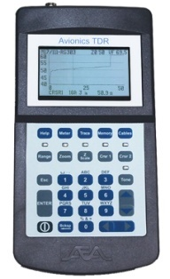
Step TDR
Step TDR Advantages =
No Dead Zones – Any Range or after faults
TDR Calibrates to Range and VF settings
Cable’s impedance and loop resistance are displayed
End of cable is clear maximum or minimum reading
Faults display in Ohms and are more clear
Detects signal ingress or RF signal presence on cable
18

Slide 19
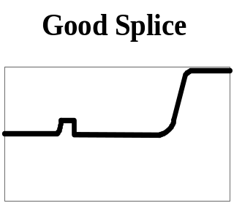
Example Step TDR Reflections
Mixed Impedances
Bridged Tap
Pinched Coax
9
10
Water
Split Pair That
Resplits
Poor Quality
Coax
Poor Splice
1
1
2
3
What a “Pulse TDR” Cannot See
19

Slide 20
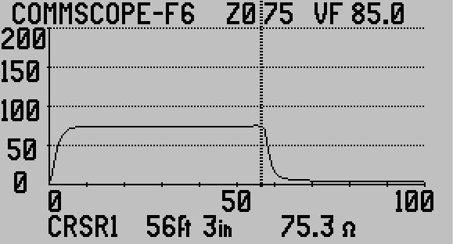
Measurement Screen
Cable Type,
Impedance, &
Velocity
1 of 2
Cursors
Impedance
Scale
Plot Range
Blinking Low
Battery indicator
(~20 minutes
power remaining)
Cursor Data – Feet, Inches or Meters and Impedance
20

Slide 21
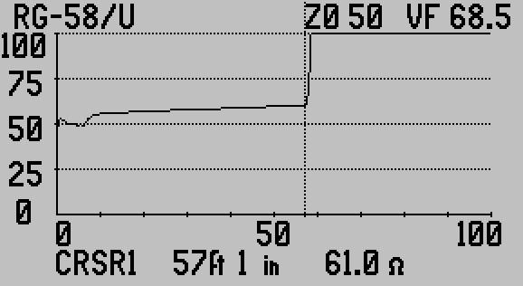
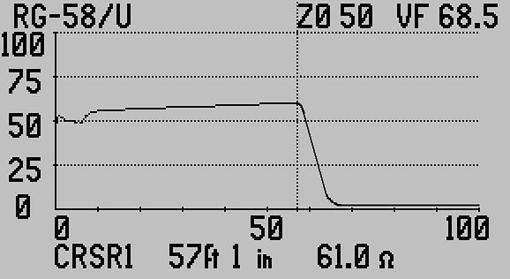
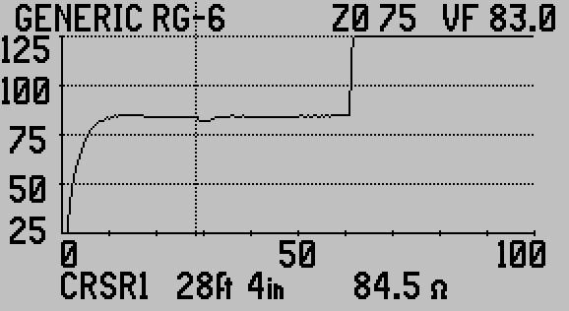
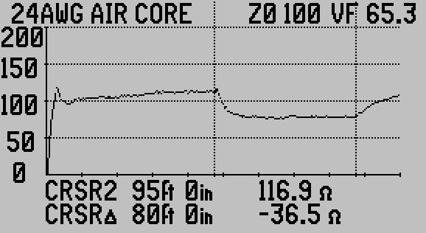
Example TDR Traces
Open Coax
Shorted Coax
Pinched Coax
Wet Cable
21

Slide 22
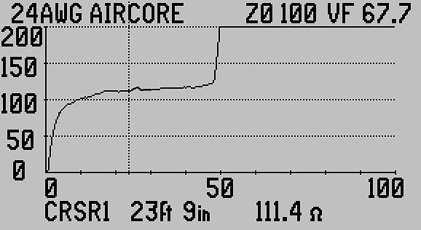

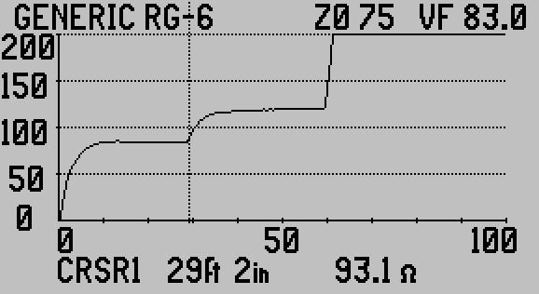
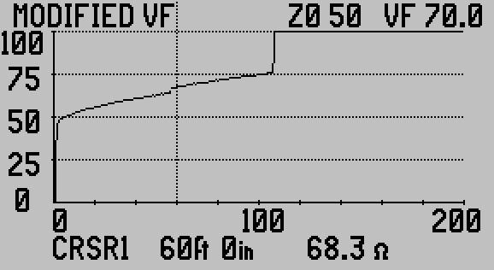
Example TDR Traces
Good Splice
Bad Splice
Series Resistive Fault
Coax Shield Fault
22

Slide 23
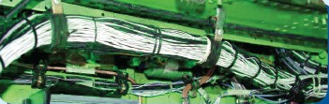
Single-wires in a Harness Impedance
Harness
Cross-section
General Rules:
More wires in the harness the lower
the overall impedance ~80-100 Ohms
2. Less wires in the harness the higher
the overall impedance ~150-200 Ohms
3. Closer the wires in the harness the
lower their impedance
Further away the wires are in a harness
the higher their impedance
Rules apply to any single-wire in the
  harness and the airframe
Airframe
All single-wires are
capacitively coupled
creating the harness’
impedance
23

Slide 24
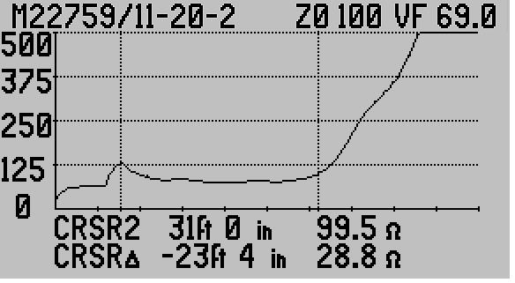
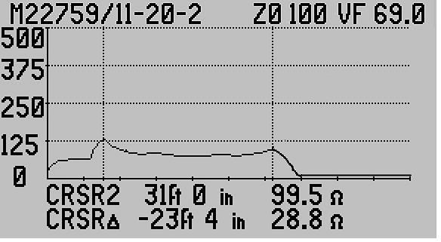
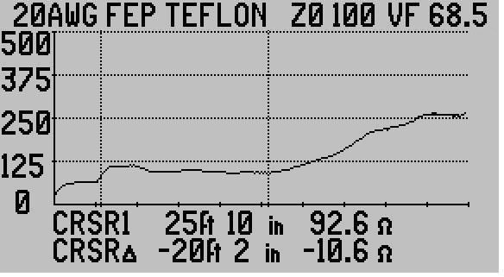
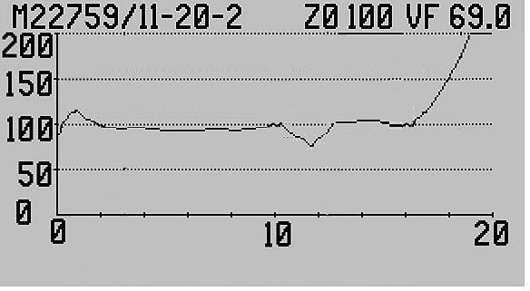
Example Single-wires in a Harness Traces
Single-wire to airframe open
Single-wire to airframe shorted
Single-wires in harness
Single-wires with fault @ 10ft
24

Slide 25
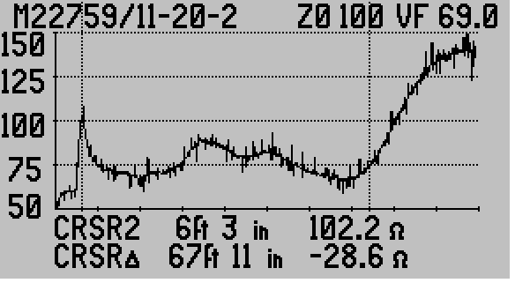
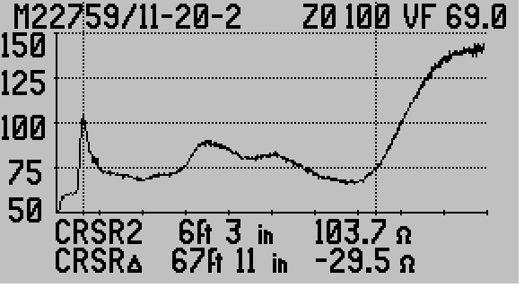
Example Avionics TDR Traces
Single-wires in harness
Single-wires in harness
Noise filter OFF
Same wires
Noise filter ON
25

Slide 26

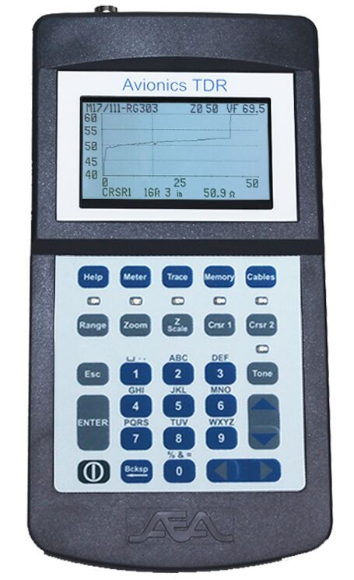
Powering Up/Down
ON cycle runs Self Test,
Calibration, and Restores
last use settings
Input over-voltage
protection to 250 VAC or DC
Input Voltage Detect Warning
(>1VAC pk-to-pk or >50VDC)
OFF cycle saves all
settings
Battery Saver shuts down
saves all settings
26

Slide 27

Soft Reset & Hard Power Down
Perform Soft Reset if: 1. TDR menu cursors are unresponsive
2. Measurement Screen disorganized
3. Other performance issues
“Default Settings” will flash
in the splash screen and
Measurement Screen will
open to 0-1KΩ Z Scale
Then
Then
1 Sec
Press & Hold
2 Sec Release
Perform a Hard Power Down if TDR will not turn off normally
Press and hold for 10 seconds
Then power on with a Soft Reset
27

Slide 28
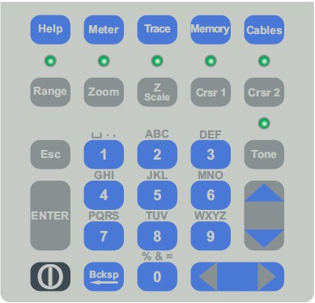
Keypad
Menu keys
By name
LED’s indicates
active Function keys
Cable ID tones
for coax &
twisted pair
Exits menu and
saves changes
Enters A/N changes,
distance marks, &
Soft Reset
Cursors, & data
selection
control
ON/OFF
Cell style alpha-
numeric entry
pad
28

Slide 29
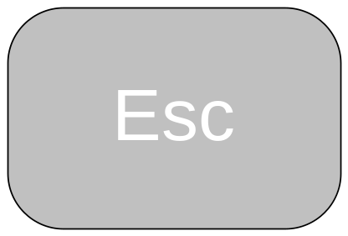
Keypad Controls
Used to confirm or accept
alpha-numeric entries, highlighted
list selections, and cursor marked
entries for certain features
Soft Reset – Press and hold, turn TDR ON,
then release ENTER.
Return to Measurement Screen
from menu or back up one menu
level. Saves all menu changes
29

Slide 30

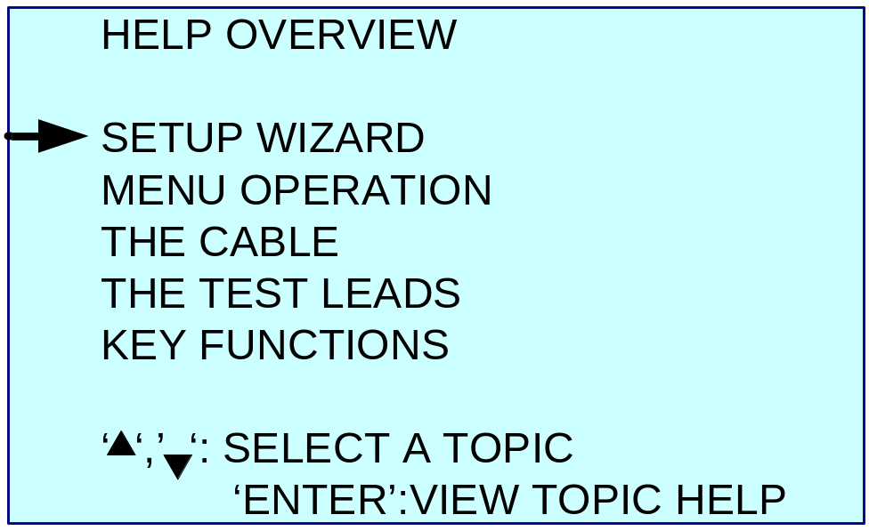
Help Key
With NO action keys or other
menu key selected
Step-by-step set up guidance
How the menus work
Cable menu options guide
Test Lead Null guide
Action keys’ LEDs guide
30

Slide 31
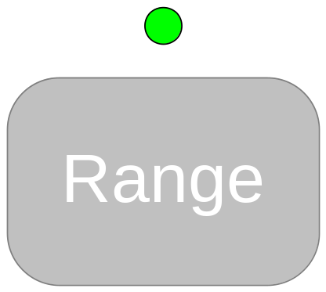
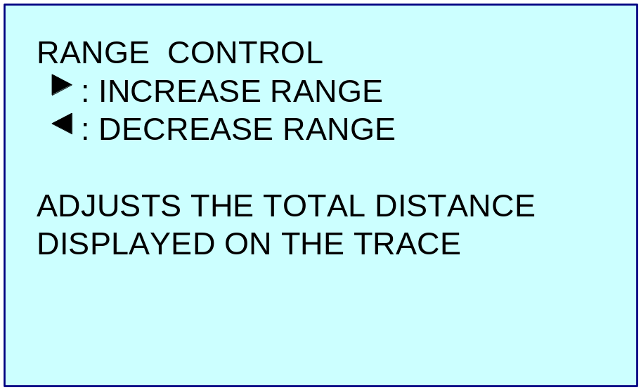
Context Sensitive Help Example
Context sensitive help works
with active Function keys
or menu keys and cursor
selected features and functions
31

Slide 32


Meter Menu
Off, Low, Med, & High
Raise for cold, lower for hot
Coax or RJ45 A thru D
ON or OFF
► to open full menu
►Sub menu to change
32

Slide 33


Trace Menu
20, 50, 100, 200, 500, & 1KΩ
10ft – 20Kft (2m – 5Km)
Offsets display range by entry.
0 = TDR connector or Test Lead
end if Test Lead Null is ON
OFF, KINKS ONLY or ALL FAULTS
(slides 37 & 38 for details)
ON or OFF
ON or OFF (slide 39 for details)
33

Slide 34





Memory Menu
34

Slide 35




Cables Menu
Find a cable’s VF from known
points – guided process
Compute a cable’s VF
by testing a sample of
known length – guided
process
35

Slide 36



Function Keys
Increase/decrease display range
Minimum 10 ft or 2m
Maximum 20Kft or 5Km
36

Slide 37

Zooms on active cursor
Zoom Limits: Minimum 10ft (2m)
to Maximum Set Range
37

Slide 38


Scales: 20, 50, 100, 200, 500, & 1KΩ
On lower Scale settings cable Z₀
will stay centered
38

Slide 39




Single active cursor has LED lit
Rules when both cursors are on screen:
1. Both LEDs are lit
2. Last cursor key touched is active
3. Last cursor key touched appears on
LCD with differential readings to other
cursor’s – distance and Ohms
39

Slide 40





Tones generated on coax or
selected twisted pair
INPUT CHANNEL:
Most standard inductive
amplifiers (probes) will pick
up the tones
TDR trace is not available
While toning the cable.
Battery Saver is suspended
Press for a menu of
Tones
40

Slide 41


Avionics TDR Advanced Features
MICRO FAULT – Locate minute defects in coax
TEST LEAD NULL – Remove unknown test lead
length from measurement
VELOCITY SEARCH – Pin-Point an installed cable’s
true VF based on cable’s
known length or known
distance to an event.
SAMPLE A CABLE – Find the VF for a cable sample
to apply to all the cable in that
box, reel or lot number.
41

Slide 42

Micro Fault
► MICRO FAULT – KINKS ONLY
For small kinks and crushes
in coax cables
TDR’s normal display will
shift to an amplified reflection
display with Z₀ as base line .
In this example a fault barely
seen in the normal impedance
display shows up clearly.
42

Slide 43

Micro Fault
► MICRO FAULT – ALL FAULTS
Mainly for coax or high
quality twisted pairs
TDR’s normal display will
shift to an amplified reflection
Display Z₀ centered, no
dribble-up & reduced Z Scale.
In this example a fault barely
Seen in the normal impedance
display shows up clearly.
43

Slide 44



Test Lead Null
Use a cursor to mark the
End of the test lead and
Press to set the length
44

Slide 45
Velocity Search
When to use – If you have an installed cable with known
lengths either to the end or an event on the cable. TDR will
compute the cable’s VF based on marking the distance with a
cursor, then use the to adjust the cable end or event to
that distance.
Press when end of
cable and cursor are aligned
to use the modified VF and
return to Measurement Screen
45

Slide 46


Sample a Cable
When to use – If you have a cable sample 10-50ft (3-15m)
with an accurately measured length, and plan to install or test
cable’s from it’s same reel or box.
Mark the end of the sample.
Press and enter ft then in.
Press TDR computes VF
46

Slide 47
Questions on Avionics TDR?
47

Slide 48
ETDR PC VisionTM Software
Operating Systems: Windows 7® , Win 8.0 or 8.1® , Win 10®
No platform license – Load on any number of PC’s
Upload saved or current traces to the PC
Archive the traces on the PC or other memory media
Upload and Download Cable Lists to the Avionics TDR
Upload and Download instrument setups to the Avionics TDR
48

Slide 49

Getting Started with ETDR PC Vision
Locate ETDR PC Vision folder on the enclosed CD-ROM
or download it from www.aeatechnology.com and install
on your PC.
Turn on the TDR and wait for the Measurement
Screen (will not communicate if off or in menus).
3. Connect the TDR and PC using the supplied USB Cable
4. Double-click the icon on the desktop to open application
49

Slide 50


User Friendly Communications Setup
ETDR PC Vision automatically scans for the TDR when it opens
FTDI Drivers
must be installed.
Drivers are located
on enclosed CD
and instructions
are in the Operator
Manual.
50

Slide 51

Get Trace Tab
51

Slide 52

Stored Traces Tab
ANTENNA 2 50 78.6 12/30/11 11:58
ANTENNA 5 50 78.6 12/30/11 12:26
CON. 401 100 67.7 1/3/12 07:39
CON. 331 100 67.7 1/3/12 08:38
SENSOR 6-1 100 72.3 1/5/12 09:11
SENSOR 6-2 100 72.3 1/5/12 09:15
FLIR 1 75 74.8 1/10/12 10:27
Press first to
upload a list
of stored
traces
Direct save TDR
memory to PC
folder
Caution – There is NO UNDELETE
52

Slide 53

Graphic Plot Screen
53

Slide 54

Setup Tab
Press either
to obtain
valid data
(gray text is
not valid)
54

Slide 55

Cables Tab
Read the Cable
List from TDR
or from a
stored list on the
PC
Write the Cable
List to the TDR
or to a stored list
on the PC
Use these keys and “Select Cable Values” to edit the list
55

Slide 56
Cleaning Your Avionics TDR
Always spray cleaners and rinse water on a soft cloth,
do NOT spray directly on the TDR
Typical Grime – Use a mild non-abrasive detergent like
409® in water or glass cleaner (non-ammonia) and rinse
water to clean
3. Cable Gel – User liquid “citrus” cleaner to remove
Tar, creosote or adhesives – Use WD40® followed with
mild detergent and water
Soft Cases
The soft case should be cleaned the same as the instrument.
Use a soft bush to remove tough dirt. Do NOT immerse in
water or dry in a dryer. Wash and Dry separately, both
instrument and case should be dry before enclosing the
instrument in the case.
56

Slide 57
Maintenance, Service and Warranty
Basic Guide or Operator Manual, Maintenance, Service & Warranty.
Warranty – One year against material & workmanship defects
See “User Troubleshooting Guide”
Email
www.aeatechnology.com
Questions, By all means – Contact us:
AEA Technology, Inc.
5933 Sea Lion Place, Ste 112
Carlsbad, CA 92010
Tel: 800-258-7805 or +1-760-931-8979
Fax: +1-760-931-8969
Application Notes
Operating Manuals
ETDR PC Vision
Data Sheets
57

Slide 58
Questions
on
Avionics TDR
ETDR PC Vision software?
Windows 7, Win 8.0 and 8.1, and Win10 are registered trademarks of Microsoft® Corp.
409 is a registered trademark of Clorox® Corp.
WD-40 is a registered trademark of WD-40® company
58

